Slide 1
Talent Analytics for AI Resume Screening
BIA 660 Final Project
Harshil Cherukuri, Ratan Chowdary Paruchuri, Sidharth Peri
Notes:
Ratan

Slide 2
Overview
Motivation and Research Question
Background
Data
Vector Databases Model
Job Similarity Model
Resume Similarity Model
Resume Category Predictive Model
Next Steps
Notes:
Ratan

Slide 3
Motivation and Research Questions
Project Motivation
AI playing increasingly pivotal role in job application process
Applications of AI in talent analytics include initial resume screening
AI systems can also be used on the employer side to improve job descriptions and on an applicant side to finetune and evaluate resumes
Project Motivation: Improve an aspect of talent analytics by helping applicants bolster their resumes, and employers enhance their job descriptions.
Notes:
Ratan

Slide 4
Motivation and Research Questions
Main Research Questions
Research Question 1:
What are the linguistic characteristics of the best resumes for specific jobs and fields?
Are there common language/keywords/phrases that make certain resumes stand out and show a high degree of similarity with the job requirements?
Can we reverse this analysis to find the common language/keywords/phrases that make specific jobs stand out and show a high degree of matching with a majority of resumes?
Research Question 2:
Can a system used to match jobs on the market with resumes provide a meaningful and correct relationship between a candidate’s ideal field of choice and their best fit jobs?
Does a candidate’s resume accurately reflect their own field of interest?
Notes:
Ratan

Slide 5
Background
AI in Talent Analytics Industry
Most employers currently use either an ATS (Applicant Tracking Software) or AI resume screening to evaluate a large number of resumes in an efficient manner
Both methods are keyword based, meaning they look for specific phrases and patterns of text that match closely with the job listing requirements
These systems highlight/emphasize resumes that have a high degree of matching with job requirements
We will therefore look to mimic a similar system for our own evaluation and analysis
Notes:
Harshil

Slide 6
Data
Generating Datasets
Need 2 datasets for analysis: Resume dataset (consists of resume descriptions) and Jobs dataset (consists of job descriptions)
Resume data: Obtained from kaggle, pre-scraped dataset of approximately 200 resumes with fields for the resume category and the scraped description which included information like: education, skills, and experiences
Jobs data: Manually scraped 120 jobs with their titles and main description from Indeed using Selenium and BeautifulSoup, half being Data Science jobs and the other half Information Technology jobs
Notes:
Harshil

Slide 7
Vector Databases Model
Problem Formulation
Leverage the latest in vector database technology for semantic search to enhance job matching processes.
Design a system that analyzes job postings and matches them with queried resume to identify the most suitable job titles for candidates.
This targeted approach should allow job seekers to focus their efforts on opportunities that best match their skills and experience, streamlining the job search and improving employment outcomes.
Notes:
Ratan

Slide 8
Vector Databases Model
Methodology
The cleaned job description is vectorized using pre trained word2vec model ‘word2vec-google-news-300’
A pinecone vector database is initialized. The vectorized data is stored in a vector under 'description' namespace along with an id and title of the job posting.
The length of the vector is 300 dimensions and the space is setup to handle similarity checks with euclidean distance.
The cleaned resume data is passed a query to the database. The top 3 nearest job descriptions are selected.
The end user is presented with the job titles and id of the job posting.
Notes:
Ratan

Slide 9
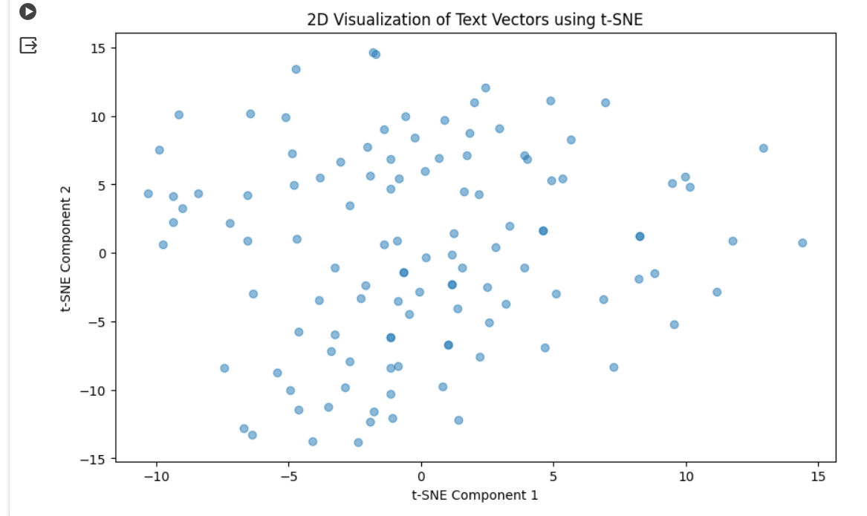
Vector Databases Model
Visualization
T-distributed Stochastic Neighbor Embedding, a dimension reduction method, is used to visualize the 300D data as 2D
Notes:
Ratan

Slide 10
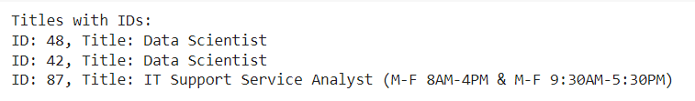
Vector Databases Model
Insights and Analysis
Let’s look at one of the output for a queried resume,
Does it not look odd?
How could a resume be nearly similar to a support job and a job that demands high technical knowledge?
Notes:
Ratan

Slide 11
Vector Databases Model
Insights and Analysis
Currently, we are using all the words of cleaned job description to create an embedding vector.
Upon deep diving into the questions, we learned a complex word extraction pipeline need to be implemented, to retrieve experience, skills that have high weight in job description.
The pipeline need to involve NLP techniques Named Entity Recognition, Pos tagging and Chunking.
This will significantly improve the results of similarity search of resume and job description.
Notes:
Ratan

Slide 12
Job Similarity Model
Problem Formulation
Idea: Create a model that shows similarity between each resume and each job and determine the “most matched jobs”
Purpose: Understand and analyze the most competitive and matched jobs to see which linguistic characteristics make a job highly desirable in an AI system
Implementation: Generate word vectors using GloVe pre-trained embeddings and TF-IDF vectors on resume and job corpus. Calculate cosine similarity between each (resume, job) pair and track top 5 most similar jobs for each resume
Notes:
Harshil

Slide 13
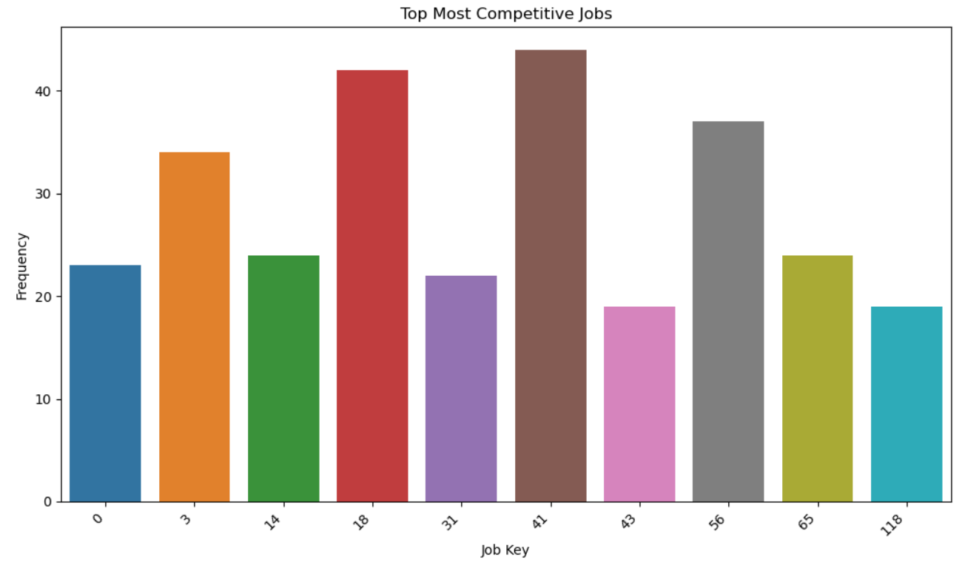
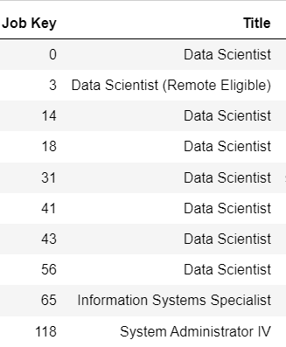
Job Similarity Model
Top Jobs (GloVe Embeddings)
Notes:
Harshil

Slide 14
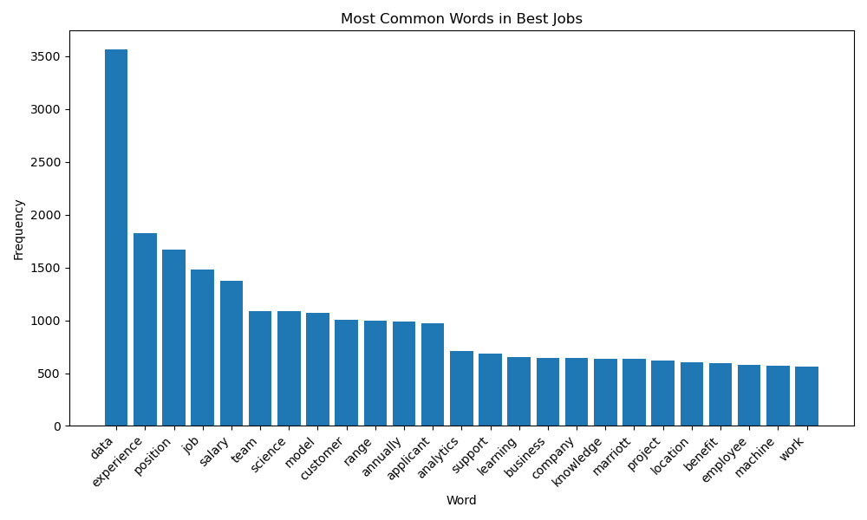
Job Similarity Model
Most Common Words (GloVe Embeddings)
“data” is by far the most occurring word in the top jobs, followed by “experience”, “position”, “job”, and “salary”
Many of the top occurring words are generic, related to corporate aspects of jobs such as pay rate, experience required, and type of position rather than skill-based
Notes:
Harshil

Slide 15
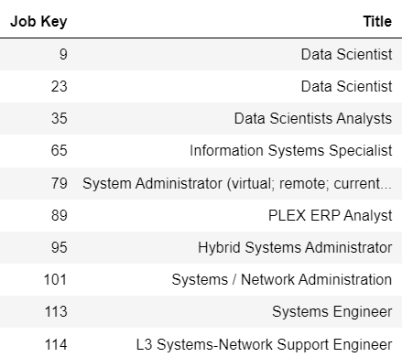
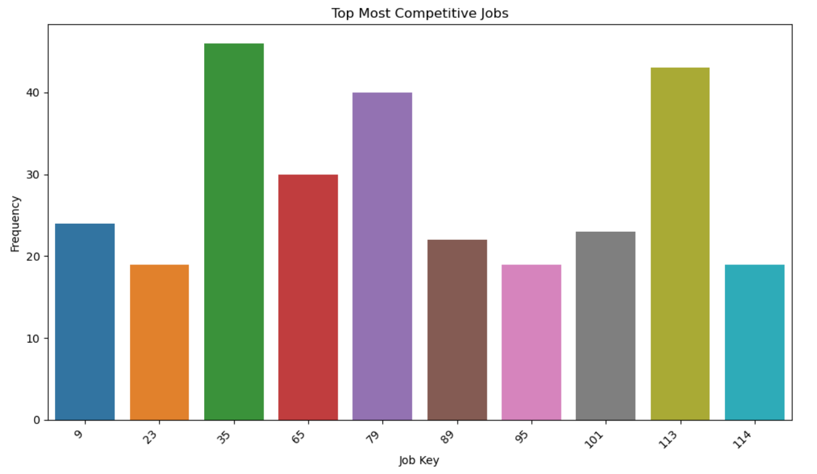
Job Similarity Model
Top Jobs (TF-IDF Vectors)
Notes:
Harshil

Slide 16
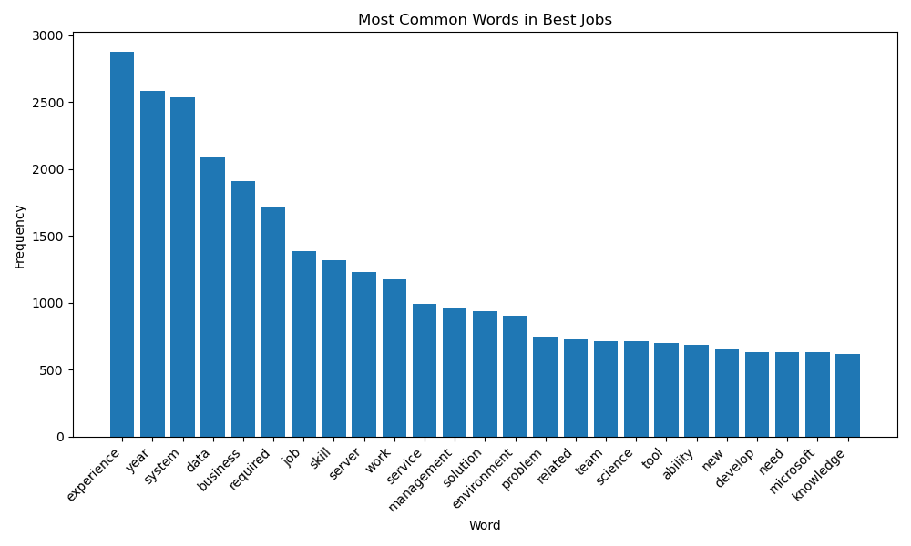
Job Similarity Model
Most Common Words (TF-IDF Vectors)
“Experience” is most common word, followed closely by “year”, “system”, “data”,“business”, and “required”
Similar results to GloVe, many of the most common words are generic, related to qualifications that may be necessary for the job
Notes:
Harshil

Slide 17
Job Similarity Model
Insights and Analysis
GloVe word embeddings and TF-IDF vectors produce similar results with regards to word similarity, but slightly different results with regards to the matched jobs
On the whole, clearly we can see a main linguistic characteristic of top jobs is including “corporate specific information” (pay rate, experience, educational qualifications)
Candidates are likely more motivated to apply for a job where all information is transparent
Notes:
HarshilHarshil

Slide 18
Resume Similarity Model
Problem Formulation
Idea: Create a model that shows similarity between each resume and each job and determine the “most matched resumes”
Purpose: Understand and analyze the most competitive and matched resumes to see which linguistic characteristics make a resume highly desirable and likely to be selected in an AI system
Implementation: Generate word vectors using GloVe pre-trained embeddings and TF-IDF vectors on resume and job corpus. Calculate cosine similarity between each (resume, job) pair and track top 5 most similar resumes for each job
Notes:
Sid

Slide 19
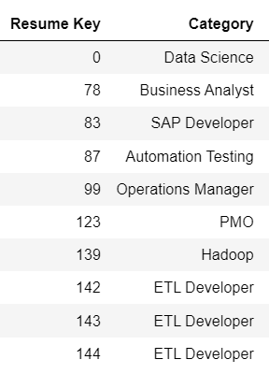
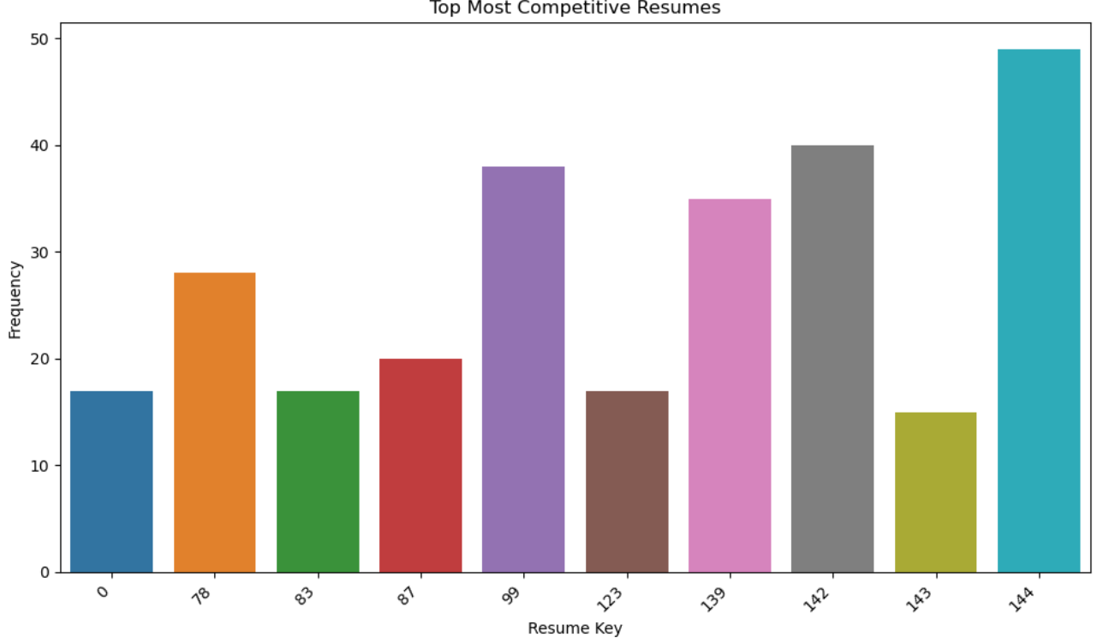
Resume Similarity Model
Top Resumes (GloVe Embeddings)
Notes:
Sid

Slide 20
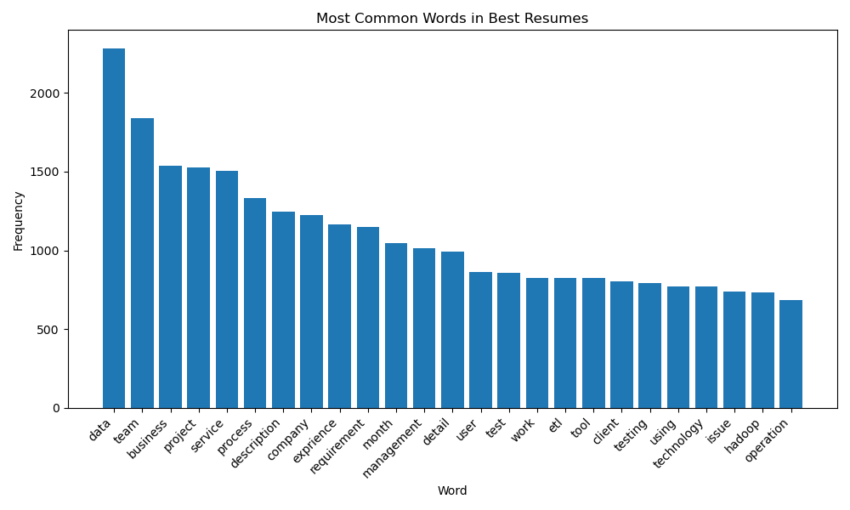
Resume Similarity Model
Most Common Words (GloVe Embeddings)
More skill-based words among the top resumes
Words like “data”, “detail”, “test”, “etl”, “technology” and “hadoop” are among the most common
Notes:
Sid

Slide 21
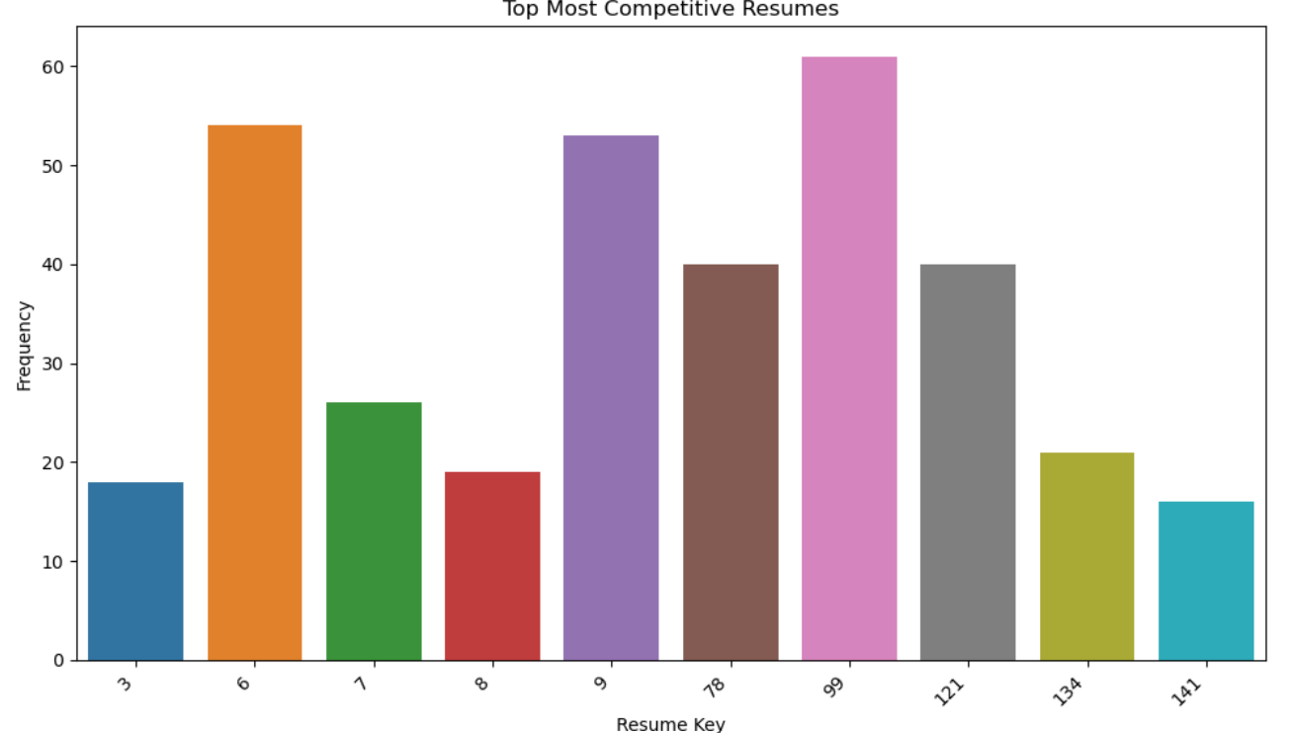
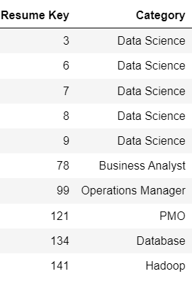
Resume Similarity Model
Top Resumes (TF-IDF Vectors)
Notes:
Sid

Slide 22
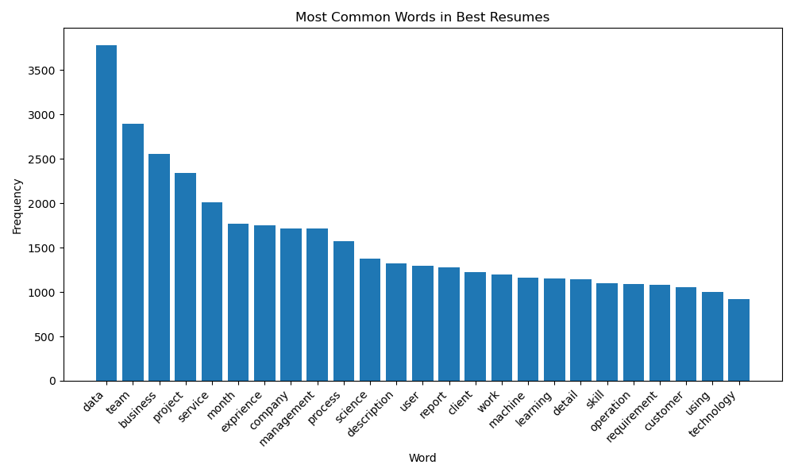
Resume Similarity Model
Most Common Words (TF-IDF Vectors)
Significant overlap between the most common words in the top resumes amongst both models
Potential bigram phrases, with words like: “data” and “science”, and “machine” and “learning” which are highly sought after skills
Notes:
Sid

Slide 23
Resume Similarity Model
Insights and Analysis
GloVe word embeddings and TF-IDF vectors produce similar results with regards to word similarity, but slightly different results with regards to the matched resumes
On the whole, clearly we can see a main linguistic characteristic of top resumes is including some aspect of “technical skills” (technology, machine learnings, data science)
Employers and their AI screens favor candidates with technical skills written on their resume
Notes:
Sid

Slide 24
Resume Category Predictive Model
Problem Formulation
Intuition: Determine whether a candidate’s resume accurately reflect their own field of interest based on how their resume text matches to job descriptions
Purpose: Some resumes may be targeted towards a non-optimal field given experiences and educational qualifications. We can find a candidate’s optimal field by training on different resumes from different fields to classify each resume.
Implementation: We implemented 2 different classification models: Random Forest and SVM to predict resume category given a set of textual features. Our models do not have the goal to maximize accuracy, as we are looking more to evaluate misclassifications to determine WHY the model may have classified a resume with a different target category than the actual and determine whether the misclassification may be a result of a improperly assigned resume
Notes:
Sid

Slide 25
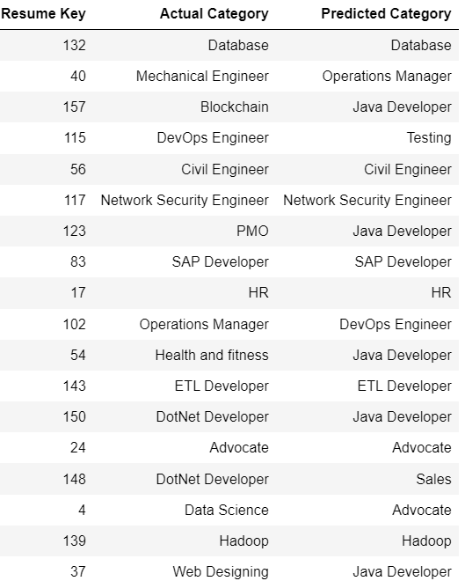
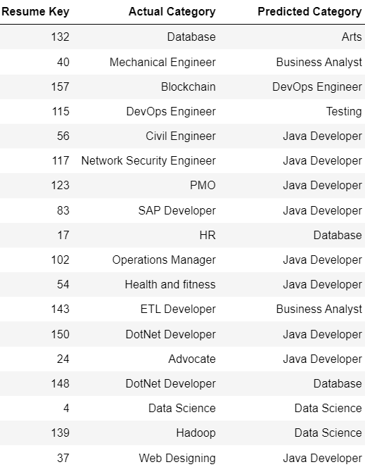
Resume Category Predictive Model
Classification Results
Random Forest Results:
Accuracy = 41%
SVM Results:
Accuracy = 12%
Notes:
Sid

Slide 26
Resume Category Predictive Model
Sample Misclassification Evaluation
Resume 37: Predicted -> Java Developer; Actual -> Web Designing
Compare most occurring words among test resume, web designing resumes, and java developer resumes
Results:
Java Developer has 9 overlapping words: “ajax”, “database”, “detail”, “developer”, “java”, “project”, “system”, “technology”, and “web”
Web Designing has 7 overlapping words: “application”, “detail”, “html”, “project”, “system”, “technology”, and “web”
We think our model classification makes sense and java developer is a better classification for this resume
Notes:
Sid

Slide 27
Resume Category Predictive Model
Insights and Analysis
Random Forest model much better performing than SVM
The model can provide us with information in order to evaluate specific misclassifications with confidence of better than random choice predictions
From evaluating specific misclassifications, we can see that sometimes users can misidentify their own resumes by having too narrow of a focus, thus restricting themselves in the job market
Broad resume categories favorable over more narrow resume categories
Notes:
Sid

Slide 28
Next Steps
Our research enabled us to build multiple models to answer and analyze important questions in talent analytics
Future research should delve deeper into refining AI-driven resume screening algorithms, focusing on incorporating industry-specific language and job requirements to enhance their ability to match candidates with suitable roles effectively
The integration of additional data sources and features, such as contextual information about job seekers and hiring organizations, holds promise in enriching the predictive capabilities of AI models
Notes:
Ratan

